Slide 1
Chapter 3 Introduction to Git and GitHub
Version Control | Local Repositories | Branching | GitHub

Slide 2
Learning Objectives
01 Explain what version control is and why it matters for infrastructure work
02 Create and manage a local Git repository using git init, git add, and git commit
03 View history and track changes with git log, git diff, and git status
04 Create and switch between branches using git branch and git switch
05 Push to GitHub and collaborate using pull requests and the GitHub CLI
Windows Server 2025 | Chapter 3 | Introduction to Git and GitHub
02

Slide 3
Introduction to Git and Version Control

Slide 4
What is Version Control?
A system that records every change to files over time, with who made it and why
Enables rollback to any previous state — mistakes become recoverable
Supports parallel development through branching and merging
Three models: local (file snapshots), centralised (SVN), distributed (Git)
Sysadmin use cases: config-as-code, script history, infrastructure automation
Windows Server 2025 | Chapter 3 | Introduction to Git and GitHub
04

Slide 5
What is Git?
Open source distributed version control system created by Linus Torvalds in 2005
Every clone contains the complete repository history — no single point of failure
Fast branching and merging are core operations, not afterthoughts
Works offline: commit, branch, and review history without a server connection
Industry standard: GitHub, Azure DevOps, and GitLab all build on top of Git
Windows Server 2025 | Chapter 3 | Introduction to Git and GitHub
05

Slide 6
Installing and Configuring Git
# Install Git on Windows Server
winget install Git.Git
# Configure your identity (required before first commit)
git config --global user.name "Your Name"
git config --global user.email "you@example.com"
# Set default branch name to main
git config --global init.defaultBranch main
# Verify configuration
git config --list
user.name=Your Name
user.email=you@example.com
init.defaultbranch=main
Windows Server 2025 | Chapter 3 | Introduction to Git and GitHub
06

Slide 7
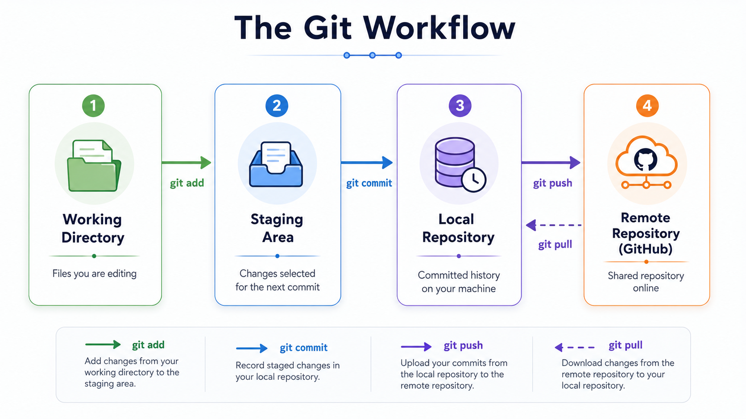
The Git Workflow
Windows Server 2025 | Chapter 3 | Introduction to Git and GitHub
07

Slide 8
Working with a Local Repository

Slide 9
Creating a Local Repository
# Create a project folder
mkdir C:\Projects\WebApp
cd C:\Projects\WebApp
# Initialise the repository
git init
Initialized empty Git repository in C:/Projects/WebApp/.git/
# .git holds all history: objects/ refs/ HEAD
git status
On branch main
No commits yet
nothing to commit (create/copy files and use git add to track)
Windows Server 2025 | Chapter 3 | Introduction to Git and GitHub
09

Slide 10
Staging and Committing
echo "# My Project" > README.md
git status
Untracked files: README.md
git add README.md # stage one file
git add . # stage everything
git status
Changes to be committed: new file: README.md
git commit -m "Initial commit: add README"
[main (root-commit) b299732] Initial commit: add README
1 file changed, 1 insertion(+)
Windows Server 2025 | Chapter 3 | Introduction to Git and GitHub
10

Slide 11
Viewing History and Tracking Changes
git log --oneline
b389f89 Add server config
ba4b620 Add deploy script
b299732 Initial commit: add README
git log
commit b389f89 Author: You Date: Tue May 19
Add server config
git diff README.md
-# My Project
+# My Project - WebApp
git show HEAD
Shows full diff + metadata of most recent commit
Windows Server 2025 | Chapter 3 | Introduction to Git and GitHub
11

Slide 12
Branching in Git

Slide 13
What is a Branch?
A lightweight movable pointer to a specific commit
main is the primary integration branch — always deployable
Feature branches isolate work in progress from stable code
Creating a branch is instant — just a new pointer reference
Merge or rebase to integrate branch changes back into main
Windows Server 2025 | Chapter 3 | Introduction to Git and GitHub
13

Slide 14
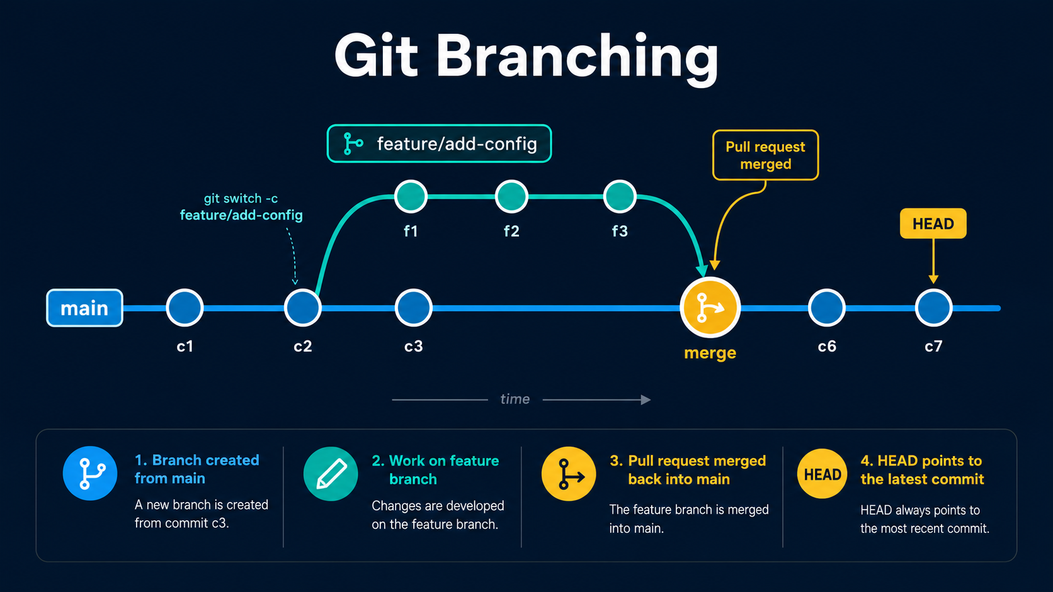

Slide 15
Creating and Switching Branches
# List branches (* = current)
git branch
* main
# Create a new branch
git branch feature/add-config
# Switch to it
git switch feature/add-config
Switched to branch 'feature/add-config'
# Create and switch in one step
git switch -c feature/new-feature
git branch
* feature/add-config main
Windows Server 2025 | Chapter 3 | Introduction to Git and GitHub
14

Slide 16
Branch Isolation in Practice
On feature/add-config
Why this matters
Changes here do not affect main
Safe experimentation without impact
Commit freely without risk
Multiple engineers work in parallel
git switch main to return
Broken code stays on the feature branch
main stays in a deployable state
Merge only when work is reviewed and tested
Windows Server 2025 | Chapter 3 | Introduction to Git and GitHub
15

Slide 17
GitHub, Pull Requests, and Collaboration

Slide 18
Introduction to GitHub
Cloud-hosted Git service owned by Microsoft since 2018
Adds web interface, issues, pull requests, Actions (CI/CD), and wiki
Public repos: open source sharing; private repos: team and org access
GitHub CLI (gh): create repos, open PRs, and merge from the command line
GitHub Free: unlimited public and private repositories for individuals
Windows Server 2025 | Chapter 3 | Introduction to Git and GitHub
17

Slide 19
Connecting to GitHub
# Authenticate once with GitHub CLI
gh auth login
# Option A: create repo and push in one step
gh repo create WebApp --public --source=. --push
# Option B: link an existing remote manually
git remote add origin https://github.com/user/WebApp.git
git push -u origin main
Enumerating objects: 5, done.
Branch 'main' set up to track 'origin/main'.
# Verify remote
git remote -v
origin https://github.com/user/WebApp.git (fetch)
Windows Server 2025 | Chapter 3 | Introduction to Git and GitHub
18

Slide 20
Creating a Pull Request
# Ensure your branch is pushed to GitHub
git push origin feature/add-config
# Create a pull request via GitHub CLI
gh pr create \
--title "Add server configuration" \
--body "Adds config.json for deployment" \
--base main
Creating pull request for feature/add-config into main
https://github.com/user/WebApp/pull/1
# View open pull requests
gh pr list
#1 Add server configuration feature/add-config OPEN
Windows Server 2025 | Chapter 3 | Introduction to Git and GitHub
19

Slide 21
Merging and Branch Cleanup
# Merge the pull request (squash into one commit)
gh pr merge --squash
Merging pull request #1 (Add server configuration)
# Switch back to main and pull the merge commit
git switch main
git pull origin main
Already up to date.
# Delete local feature branch
git branch -d feature/add-config
Deleted branch feature/add-config (was ba4b620).
# Delete remote branch if not auto-deleted
git push origin --delete feature/add-config
Windows Server 2025 | Chapter 3 | Introduction to Git and GitHub
20

Slide 22
Key Git Commands
Setup and History
Branching and Remote
git init — initialise a repository
git branch — list or create branches
git config — set user.name / user.email
git switch -c — create and switch
git add — stage changes
git merge — merge branch into current
git commit — record staged snapshot
git push — upload commits to remote
git log / --oneline — view history
git pull — fetch and merge remote
git diff — show unstaged changes
gh pr create — open a pull request
Windows Server 2025 | Chapter 3 | Introduction to Git and GitHub
21

Slide 23
Chapter Summary
01 Git is a distributed VCS that records every change with full history
02 Local workflow: git init then git add then git commit then git log
03 Branches let you work in isolation without disrupting the main branch
04 GitHub hosts remote repositories and enables structured team collaboration
05 Pull requests provide code review and a clear audit trail before merging
Windows Server 2025 | Chapter 3 | Introduction to Git and GitHub
22

